Slide 1
QCCR • RESEARCH PRESENTATION
GEOMETRY-AWARE
QUANTUM CLOUD
Getting a better Bell pair
Routing, noise, and the cost of throwing away attempts
01 MAKE
02 BREAK
03 PROTECT
04 INNOVATE

Slide 2
We measure the pair, the work, and the retries
We test a shared quantum state with three measurement settings: XX, YY, and ZZ.
What the measurements should show
Fidelity F: similarity to the target pair
Basis | Ideal relationship
ZZ | Equal bits: 00 or 11
XX | Equal bits: 00 or 11
YY | Opposite bits: 01 or 10
1 is ideal. A higher value means the measured correlations are closer to the target.
Yield: the fraction of attempts we keep
If 1,000 attempts produce 520 passes, yield is 52%. The other 480 still cost gates.
Target: (|00⟩ + |11⟩) / √2
F = (1 + ⟨XX⟩ − ⟨YY⟩ + ⟨ZZ⟩) / 4
2

Slide 3
The fixed endpoints determine the route
A dot is a physical qubit. A line is an allowed neighbor link. Orange dots are the required output ports.
2016-Inspired (reference)
IBM snapshot
Hyperbolic patch
0
0
14
3
15
25
Ports 0 and 3
3 links apart
Ports 0 and 15
6 links apart
Ports 14 and 25
7 links apart
3

Slide 4
Two SWAPs turn a short route into seven CNOTs
2016 example: first make the pair on the middle link, then move each half to an endpoint.
q0 |0⟩
M
1 + 2 × 3 = 7
q1 |0⟩
H
CNOT gates after compilation
q2 |0⟩
q3 |0⟩
●—⊕ CNOT
×—× SWAP
M measurement
H creates superposition
M
Prepare the Bell pair:
H creates superposition
CNOT creates entanglement
(|00⟩ + |11⟩) / √2
Same circuit: F = 1.000 without noise → 0.862 with the official noise
4

Slide 5
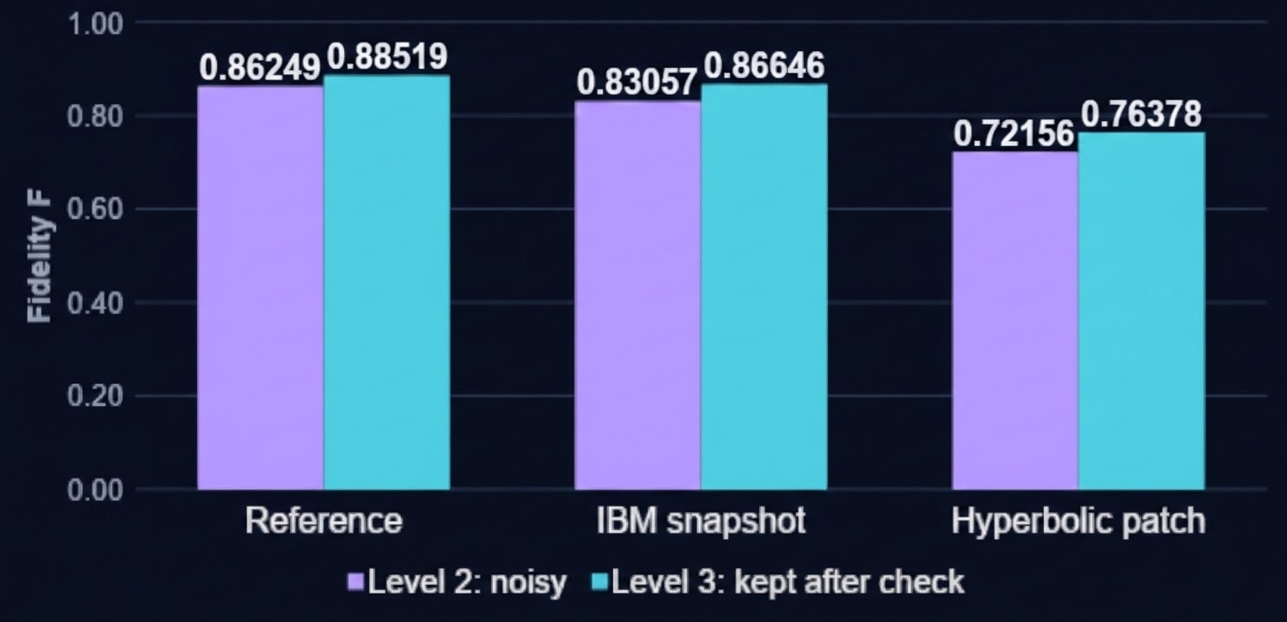
Checking raises the score of the kept sample
MAKE: ideal F = 1.000 → BREAK: add official noise → PROTECT: check parity and keep reported passes.
Kept attempts in Level 3
Model | Kept
Reference | 85.7%
IBM snapshot | 82.2%
Hyperbolic | 72.3%
The check selects a cleaner sample while spending more gates and attempts.
5

Slide 6
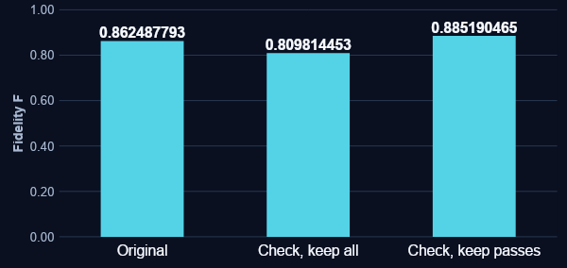
The check adds noise; selection removes many bad attempts
Reference circuit: compare the original run, the checked run before filtering, and only its reported passes.
Two CNOTs record the parity
A
B
m |0⟩
⊕
⊕
M
Logical check; hardware routing adds SWAPs.
85.7% of attempts accepted
7 → 17.5 CNOTs per accepted result
A phase error can still pass this check. Equal Z bits are only part of the Bell-state test.
6

Slide 7
Level 4 connects the endpoints by measuring the middle
Build a superposition of 0000 and 1111. Measure the middle, then correct the endpoint sign.
q0
Z*
3 CNOTs
q1
H
H
M
All attempts kept
q2
H
M
reported bits
q3
H then M measures X.
*Apply Z if the two
reported bits differ.
Shared four-qubit state → two-qubit Bell pair
00 or 11 → no phase correction 01 or 10 → apply Z
Z fixes a possible minus sign between the Bell-state terms, 00 and 11.
7

Slide 8
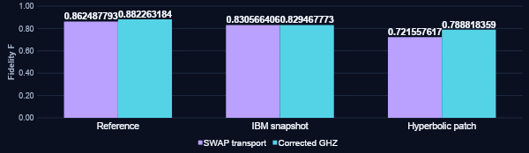
Fewer gates help on both synthetic routes
Corrected GHZ keeps every attempt. The IBM result stays about the same despite the large gate saving.
CNOTs / attempt | Reference | IBM snapshot | Hyperbolic
SWAP → GHZ | 7 → 3 | 16 → 6 | 19 → 7
8

Slide 9
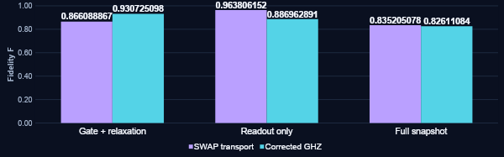
IBM readout errors offset the saving in gates
We reran the same circuits while turning noise components on separately.
GHZ saves noisy gates, but it relies on correctly reading the middle qubits.
9

Slide 10
Level 5 keeps attempts where neighboring data qubits agree
Spread one Bell half across neighboring data qubits. Check agreement, then decode it back to one output.
Encode
Check neighbors
Decode
one data qubit → three
same / different
three data qubits → one
Expected out of 1,000 | Data pattern | Check result
512: no bit flips | 000 and 111 remain linked | Keep: desired Bell pair after decoding
480: some bits flip | Neighbor disagreement | Reject
8: all three flip | All still agree | Keep: bit-flipped Bell pair after decoding
Each of the three data qubits has an independent 20% chance of a storage bit flip.
520 kept attempts
512 / 520 = 0.985 fidelity
A group that agrees is much more likely to have no flips than to have every bit flipped.
10

Slide 11
Three data qubits reach the example 0.95 target at lower cost
More data qubits suppress all-flip passes, but add noisy gates and reduce the fraction kept.
Data qubits | Fidelity [95% interval] | Kept | CNOTs / kept shot
1 | 0.794 [0.788, 0.800] | 100.0% | 1.00
2 | 0.929 [0.924, 0.933] | 67.7% | 7.38
3 | 0.972 [0.968, 0.975] | 51.7% | 17.42
7 (path) | 0.978 [0.973, 0.983] | 20.5% | 122.00
7 (closed cycle) | 0.975 [0.970, 0.980] | 20.8% | 129.78
Independent confirmation
F: 0.795 → 0.972 | 51.8% of attempts kept
11

Slide 12
Meet the fidelity target with the least gate work
Have the cloud compiler choose the protocol using fidelity and the cost of retries.
Delivery
IBM readout
Bit-flip storage
Try corrected GHZ on the synthetic routes.
It improves fidelity with fewer CNOTs and keeps every attempt.
Improve intermediate measurements before relying on GHZ’s gate savings.
A wrong reported bit can select the wrong correction.
For the tested 0.95 target, use three data qubits.
F ≈ 0.972; keep ≈ 52%; about 17.4 CNOTs per kept shot.
12

